Slide 1

Mustang industrial development
Wsup19-0019
Board of adjustment
December 5, 2019

Slide 2
location

Slide 3
goal
  Bring site into compliance.
  Allow owner to use site.

Slide 4
Site history
Site was previously used as a quarry.
Scannell Properties originally began developing site several years ago. Project put on hold.
Original contractor did not finalize several permits, creating confusion when project was re-started in 2018.
Scannell has since performed many useful upgrades to the area, such as Mustang Road improvements and fire safety upgrades.

Slide 5
Amended Conditions of approval – Item 1
The project applicant understands the need to bring the site into general conformance with the area, but requests the following revision:
Planning/Building Condition –
1. j. Any combination of boulders (24” or greater in size), not to exceed a total of four boulders (24” or greater in size) may be placed in a cluster to mimic natural rock outcroppings. Clustering of boulders shall not result in more than 45 boulders (24” or greater in size), remaining partially exposed, greater than 12” in height, in any 10,000 sf area. Clusters shall not be located within 25 feet of each other.

Slide 6
Amended Conditions of approval – item 2
Mitigation/Remediation of rocks:
Scanell Properties has been conducting rock remediation and plans to continue to do so.
Scannell is concerned about the subjective nature of the required mitigation. It is very difficult to distinguish between natural and disturbed areas of the site, given the site history (e.g. quarrying operations).
Scannell requests that several conditions of approval related to burying of rocks be revised/eliminated, based on the following:

Slide 7
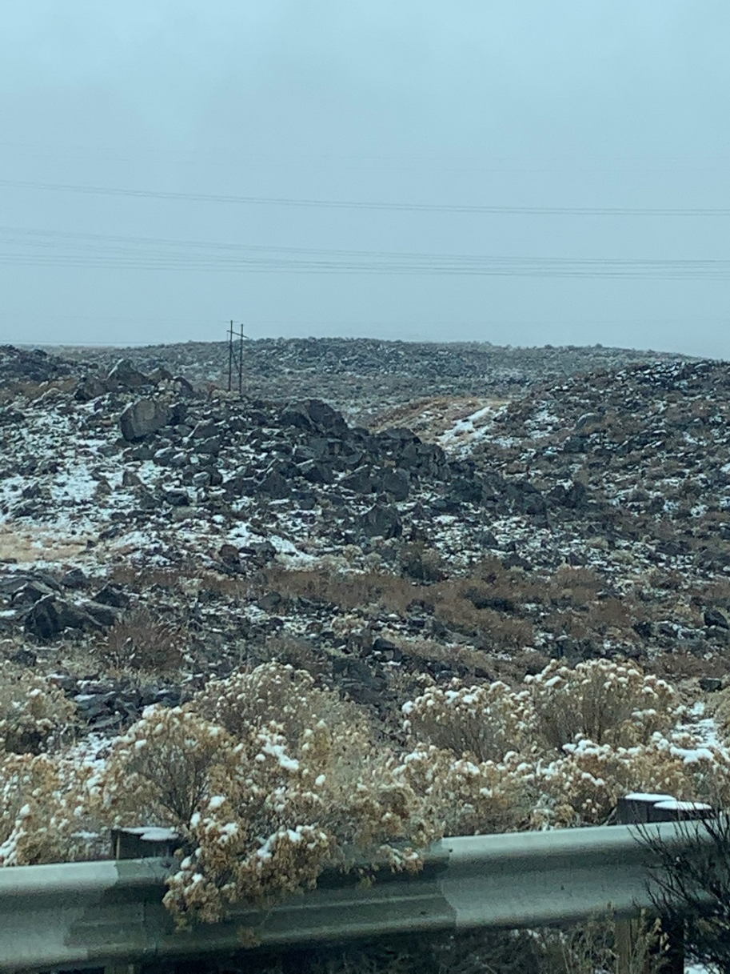
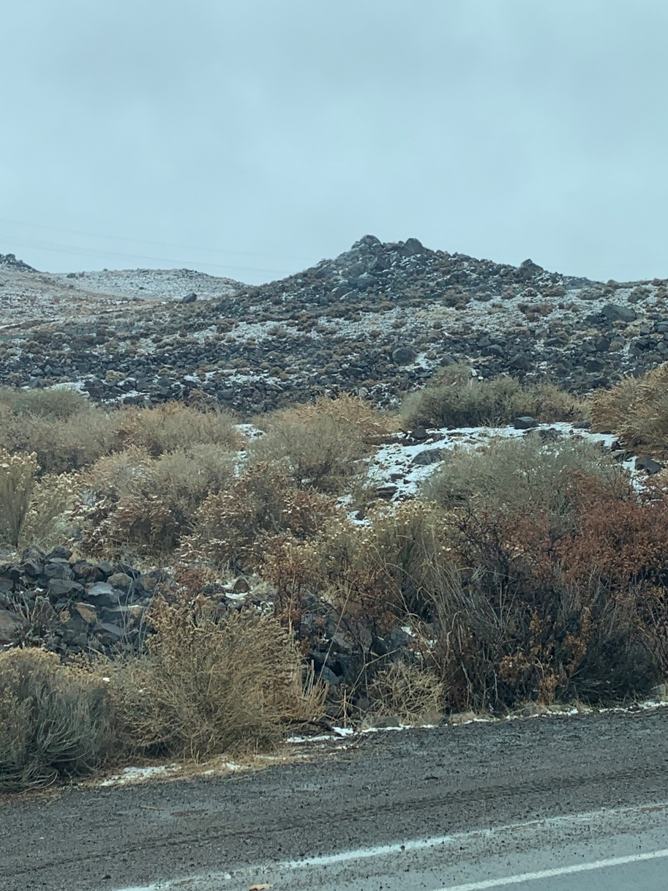
Example of subjective nature of mitigation adjacent property views

Slide 8
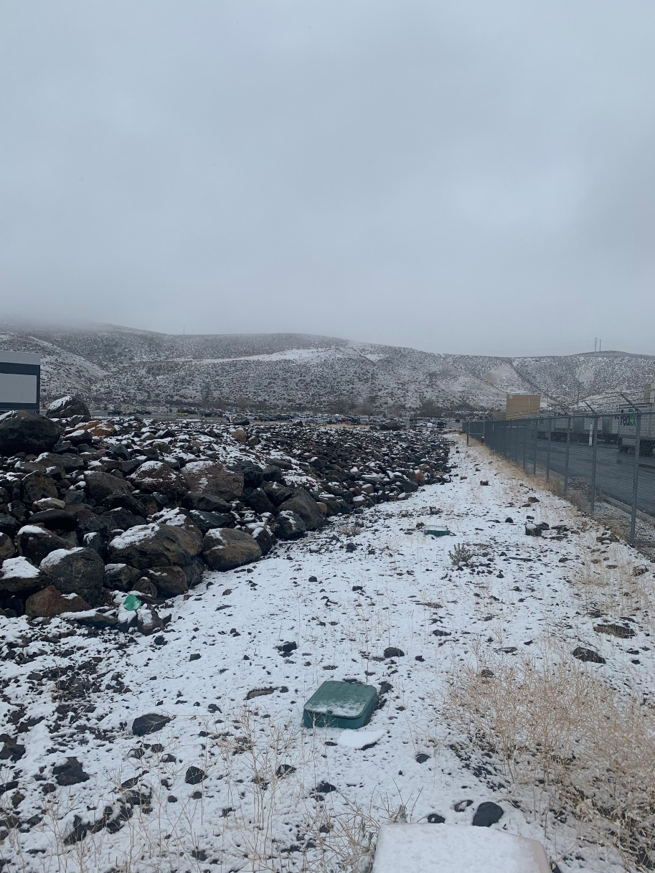
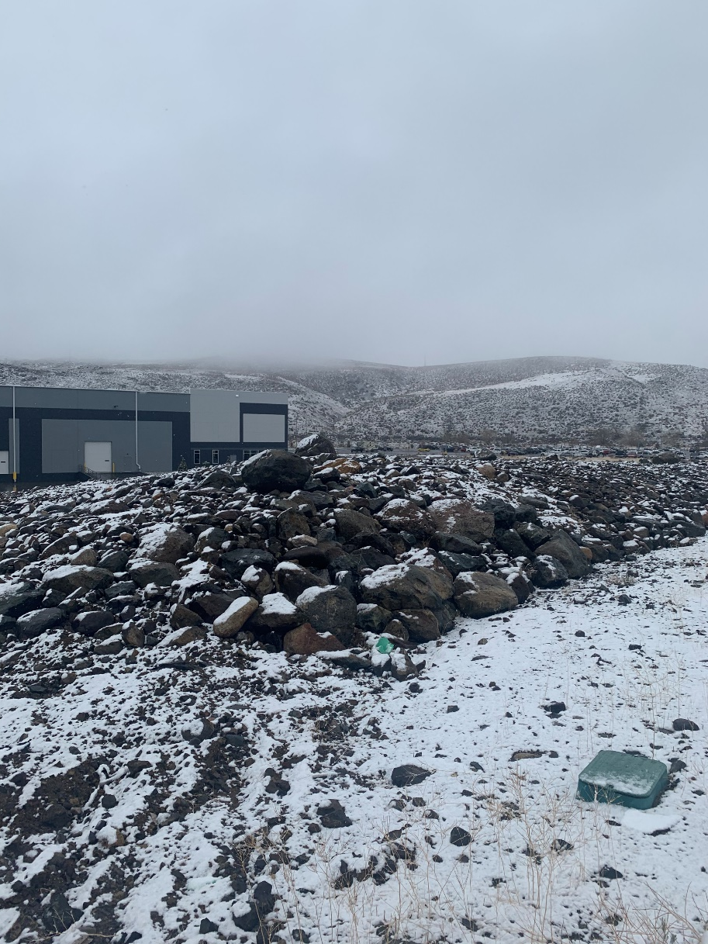
Example of subjective nature of mitigation subject property
The site is generally similar to other property in the area.
The area is characterized by rocky, desert conditions.
Burying of rocks seems unnecessary and of little value.
Site is not highly visible to surrounding area.

Slide 9
Proposed Condition revision/elimination
Revised Planning Condition 1.d. - All piles of rocks and boulders shall be treated with topsoil and revegetated in accordance with the revised landscape plans submitted by the applicant on November 4, 2019 (Sheet L-1 and L-2 by L.A. Studio Nevada, dated 10/30/19).
Eliminated Conditions:
f. After application of topsoil, a minimum of 40% of the rock pile areas shall be covered with topsoil. Not more than 60% of the rock pile areas shall be comprised of exposed rocks or boulders.
g. All rocks remaining partially exposed after application of topsoil shall be 12” or less in height above the adjacent topsoil.
i. Any single boulder (24” or greater in size) remaining partially exposed, greater than 12” in height, after application of topsoil shall be spaced at least 15 feet from any other any single boulder (24” or greater in size) remaining partially exposed, greater than 12” in height.

